Slide 1
CHURN ANALYSIS: A SYSTEMATIC APPROACH TO CUSTOMER RETENTION USING SAS
Churn Analysis: A Systematic Approach to Customer Retention Using SAS
12-Jan-23

Slide 2
Executive Summary and Introduction
Churn, also known as attrition rate, is one of the biggest challenges in businesses, especially telecommunications.
Business Goal
Our goal is to run a profitable business operation by reducing expenditure on new customer acquisition through data-driven customer retention strategies.
Project Goal/Objectives
To minimize churn, and enhance retention by:
Investigating the relationship between sociodemographic attributes, customer account information, service, and churn.
Determining the factors influencing churn
Churn Analysis: A Systematic Approach to Customer Retention Using SAS

Slide 3
Methodology
Data Source
Data was sourced from www.kaggle.com
Variables
Analytical tools
Exploratory data analysis, Basic statistics, chi-square test, two-sample t-test, ANOVA and correlation
Variable Type | Variables in Dataset
Categorical | Internet service, Contract type, Payment method
Binary categorical | Gender, Senior Citizens, Multiple lines, Online security, Online backup, Device protection, Streaming, Churn
Quantitative | Tenure, Monthly charge, Total charge, Tech support
Churn Analysis: A Systematic Approach to Customer Retention Using SAS
12-Jan-23

Slide 4
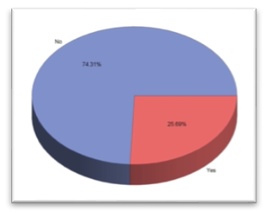
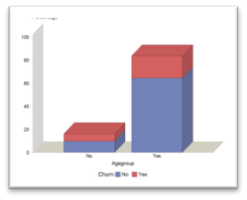
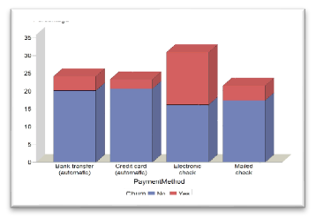
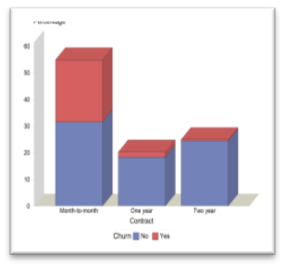
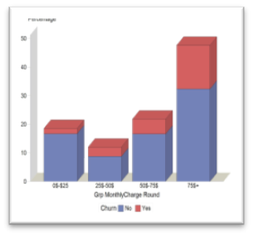
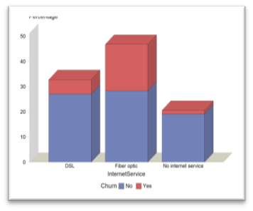
Exploratory Data Analysis
Monthly Churn Status
Churn by Age group
Churn by Payment Method
Churn by Contract Type
Churn by Internet Service
Churn by Monthly charge
12-Jan-23
Churn Analysis: A Systematic Approach to Customer Retention Using SAS

Slide 5
Chi-square Test
 | Value | DF | Prob
Churn by age-group | 19.934 | 1 | <0.001
Churn by payment method | 119.05 | 3 | <0.001
Churn by internet service | 95.24 | 2 | <0.001
Churn by contract duration | 184.28 | 2 | <0.001
P-value is less than 0.05 for all the variables considered. This means that there is a relationship between the churn and age-group, churn and payment method, churn and internet service, and churn and contract duration.
Churn Analysis: A Systematic Approach to Customer Retention Using SAS
12-Jan-23

Slide 6
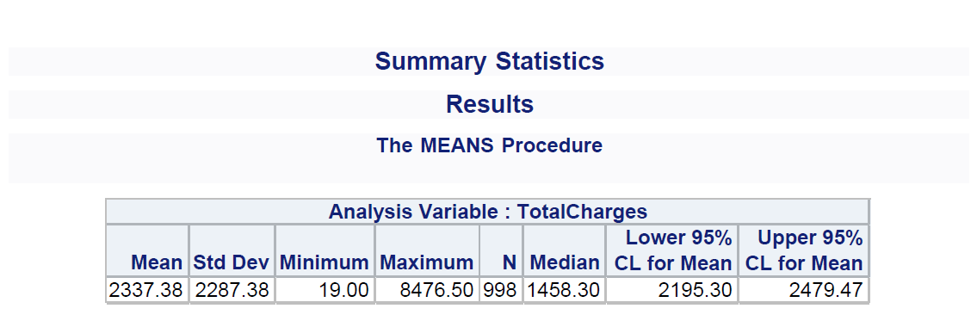
Basic Statistics
The high value of the Standard Deviation SD indicates that the value of the monthly charge are far from the mean.
The sample mean do not appear to be a fairly accurate depiction of the monthly charge
The median is the fair representation of the average monthly charged amount
Churn Analysis: A Systematic Approach to Customer Retention Using SAS

Slide 7
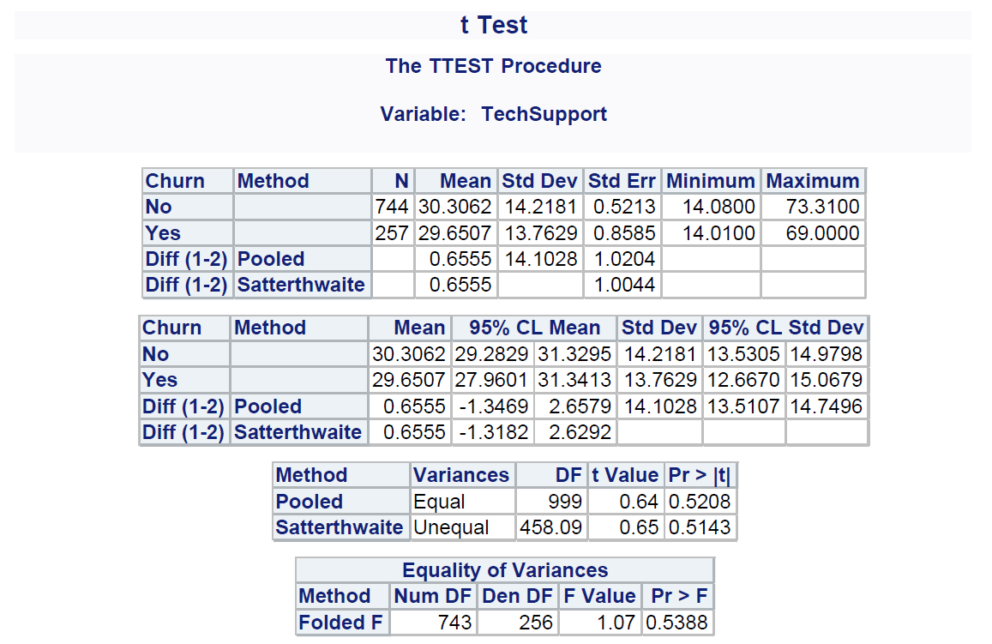
Two-sample T-test
Result shows that the F value for the test of variance is more than 0.05 and this made us accept the hypothesis that the variances are equal, we thus assume equal variances between the two groups. However, since the P value for both Pooled and Satterthwaite are greater than 0.05, then this suggest that there is no statistically significant difference between the mean of Yes (churned) and No (active) customers.
Churn Analysis: A Systematic Approach to Customer Retention Using SAS

Slide 8
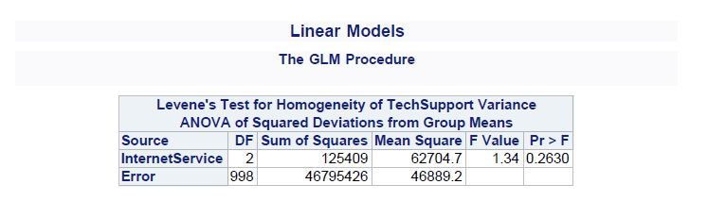
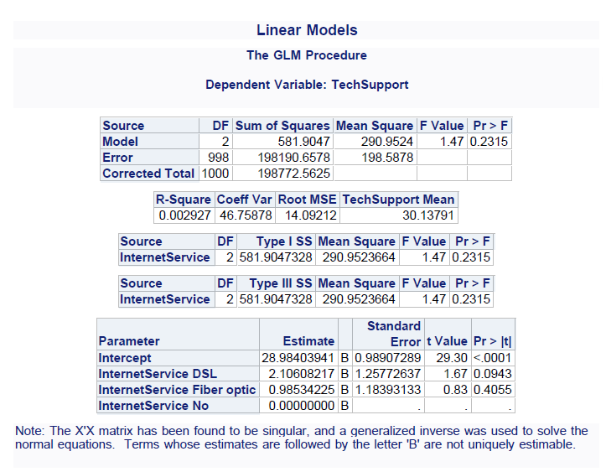
ANOVA
Churn Analysis: A Systematic Approach to Customer Retention Using SAS

Slide 9
ANOVA
Using the Levene's Test for Homogeneity of Tech support Variance ANOVA of Squared Deviations from Group means, the P-value (0.263) is significantly higher than 0.05 and this suggest that we cannot reject the null hypothesis that the variance or the standard deviation between the three internet services are equal. Thus, we assume that the variance between the three internet services are equal.
Churn Analysis: A Systematic Approach to Customer Retention Using SAS

Slide 10
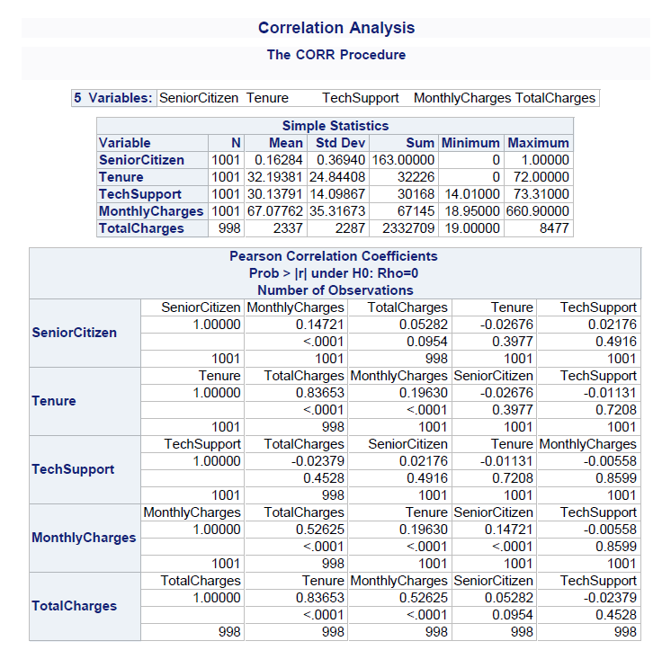
Correlation
Churn Analysis: A Systematic Approach to Customer Retention Using SAS

Slide 11
Correlation
Senior Citizen vs Monthly Charge - Given that the P value (< 0.0001) is small (and it is below the 0.05 threshold) and there is a small positive coefficient between the Senior Citizen & Monthly charges, we can conclude that there is a meaningful and statistical correlation between Senior citizen (Age of customers) and the monthly charges. That is the amount a customer spends monthly (or the amount that a customer is charged monthly) increases with age of the customer, this is because it is a positive correlation.
Senior Citizen vs Total Charge – Given that the P value (0.0954) is greater than 0.05, we cannot reject the null hypothesis that the correlation coefficient is equal to zero
Further analysis to test for correlation between Tech support against Senior Citizen, Monthly Charge and Total Charge, we can conclude that the Monthly Charge and Total Charges are significantly correlated with Tech support
Churn Analysis: A Systematic Approach to Customer Retention Using SAS

Slide 12
Summary, Conclusion and Recommendation
Analysis revealed key insights into some of the reasons why customers churned. This include age, payment method, contract duration, total charges, internet services, and tech support services.
The highest churners included junior citizens, customers who paid via electronic check, had a monthly contract and spent most times seeking Tech support.
The recommendations are creating promotional offers and tailoring them to meet individual needs, providing loyalty programs for long term customers, offering competitive pricing, creating more values added service, introducing a Customer Satisfaction Survey (CSAT) to understand customers’ needs and improve services accordingly.
Churn Analysis: A Systematic Approach to Customer Retention Using SAS

Slide 13
Thank you
Churn Analysis: A Systematic Approach to Customer Retention Using SAS
12-Jan-23

